Slide 1
Azure Kubernetes Service
Amit Malik
Bangalore Azure User Group

Slide 2
Donate for Kerala Flood Victims
Paytm to 88930-88932

Slide 3
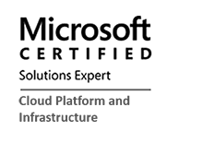



About the Presenter
Amit Malik
Director of Technology
SPEKTRA SYSTEMS
Enable people and organizations to achieve more with the help of effective business and technology innovation.
amit@spektrasystems.com

Slide 4

Table of contents
Introduction
Kubernetes Overview
Demo
Questions
Azure Kubernetes Service Overview
Running Containers in Azure
Hands-on Lab

Slide 5


Containers and Kubernetes momentum
“By 2020, more than 50% of enterprises will run mission-critical, containerized cloud-native applications in production.”
Half of container environment is orchestrated.¹
77%
77% of companies² who use container orchestrators choose Kubernetes.
The average size of a container deployment has grown 75% in one year. ¹
Larger companies are leading the adoption.¹
50%
75%
Nearly 50% of organizations¹ running 1000 or more hosts have adopted containers.
1: Datadog report: 8 Surprising Facts About Real Docker Adoption
2: CNCF survey: cloud-native-technologies-scaling-production-applications

Slide 6
Kubernetes: the industry leading orchestrator
Portable
Public, private, hybrid, multi-cloud
Extensible
Modular, pluggable, hookable, composable
Self-healing
Auto-placement, auto-restart, auto-replication, auto-scaling

Slide 7
How Managed Kubernetes on Azure works
Azure managed control plane
API Server
etcd store
Master Node(s) – self managed
Automated upgrades, patches
High reliability and availability
Easy and secure cluster scaling
Self-healing
API server monitoring
Control plane at no charge
User
App/workload definition
Kubernetes API endpoint
Scheduler
Controller Mgr
Cloud Controller
Schedule pods over private tunnel
Customer VMs
Docker
Docker
Docker
Docker

Slide 8
From infrastructure to innovation
Managed Kubernetes empowers you to do more
Focus on your containers and code, not the plumbing of them.
Responsibilities | DIY with Kubernetes | Managed Kubernetes on Azure
Containerization
Application iteration, debugging
CI/CD
Cluster hosting
Cluster upgrade
Patching
Scaling
Monitoring and logging
Customer
Microsoft

Slide 9
Azure Kubernetes Service (AKS)
Simplify the deployment, management, and operations of Kubernetes
Deploy and manage Kubernetes with ease
Scale and run applications with confidence
Secure your Kubernetes environment
Accelerate containerized application development
Work how you want with open-source tools & APIs
Set up CI/CD in a few clicks

Slide 10
Azure Kubernetes Service (AKS) Kubernetes made easy – get the most complete and simple end-to-end experience for seamless Kubernetes lifecycle management on Azure
Deploy and manage Kubernetes with ease Free managed control plane for auto upgrades, patching and self healing Provision with portal, CLI, ARM, or Terraform Full visibility with integrated monitoring and logging | Scale and run applications with confidence Built-in auto scaling Global data center to boost performance and reach Elastically burst from AKS cluster using ACI | Secure your Kubernetes environment Control access through AAD and RBAC Safeguard keys and secrets with Key Vault Secure network communication with VNET and CNI
Accelerate containerized application development Define, install and upgrade apps easily with Helm Automatically scaffold, containerize and deploy with CLI or Visual Studio Rapidly iterate, test and debug microservices using Dev Spaces | Work how you want with open-source tools & APIs 100% open source Kubernetes Take full advantage of services and tools in the ecosystem Easily integrate with SLA-backed Azure services with OSBA | Set up CI/CD in a few clicks Three steps away from a CI/CD pipeline with DevOps Project Work with existing tools such as Jenkins Geo-replicated container registry

Slide 11
Kubernetes on Azure usage grew 10x Kubernetes on Azure customers grew 5x …over the last 12 months
Azure Kubernetes momentum

Slide 12
Azure makes Kubernetes easy
Deploy and manage Kubernetes with ease
Task | The Old Way | With Azure
Create a cluster | Provision network and VMs Install dozens of system components including etcd Create and install certificates Register agent nodes with control plane | az aks create
Upgrade a cluster | Upgrade your master nodes Cordon/drain and upgrade worker nodes individually | az aks upgrade
Scale a cluster | Provision new VMs Install system components Register nodes with API server | az aks scale

Slide 13
Azure makes Kubernetes easy
Accelerate containerized application development
Task | The Old Way | With Azure
Build a containerized app and deploy to Kubernetes | Build the app resource Define a Dockerfile/Helm chart Build the container image Push the container to a registry Write Kubernetes manifests/Helm chart Deploy to Kubernetes | draft init to configure your environment draft create to auto-create Dockerfile/Helm chart draft up to deploy to Kubernetes
Build and test individual services in a microservices architecture | Set up a local dev environment using Minikube Determine the transitive closure of dependencies Identify behavior of dependencies for key test cases Stub out dependent services with expected behavior Make local changes, check-in, and hope things work Validate with application logs | Use DevSpaces to iterate, test and debug Do breakpoint debugging in your IDE
Expose web apps to the internet with a DNS entry | Deploy an ingress controller Create a load-balanced IP for it Add an ingress resource to your deployment Acquire a custom domain Create a DNS A-record for your service | Turn HTTP application routing on in your cluster Add an ingress resource to your deployment

Slide 14
Azure makes Kubernetes easy
Set up CI/CD in a few clicks
Task | The Old Way | With Azure
Set up a CI/CD pipeline and deploy to Kubernetes | Create git repo Create a build pipeline Create a container registry Create a Kubernetes cluster Configure build pipeline to push to container registry Configure build pipeline to deploy to Kubernetes | Create an Azure DevOps project with AKS as a target
Make container images available for deployment worldwide | Create a container registry in every region Configure build pipeline with multiple endpoints Loop through all regions and push following build | Create an Azure Container Registry with geo-replication Push your image to a single endpoint
Track health with consolidated cluster and application logs | Choose a logging solution Deploy log stack in your cluster or provision a service Configure and deploy a logging agent onto all nodes | Checkbox “container monitoring” in the Azure portal

Slide 15






















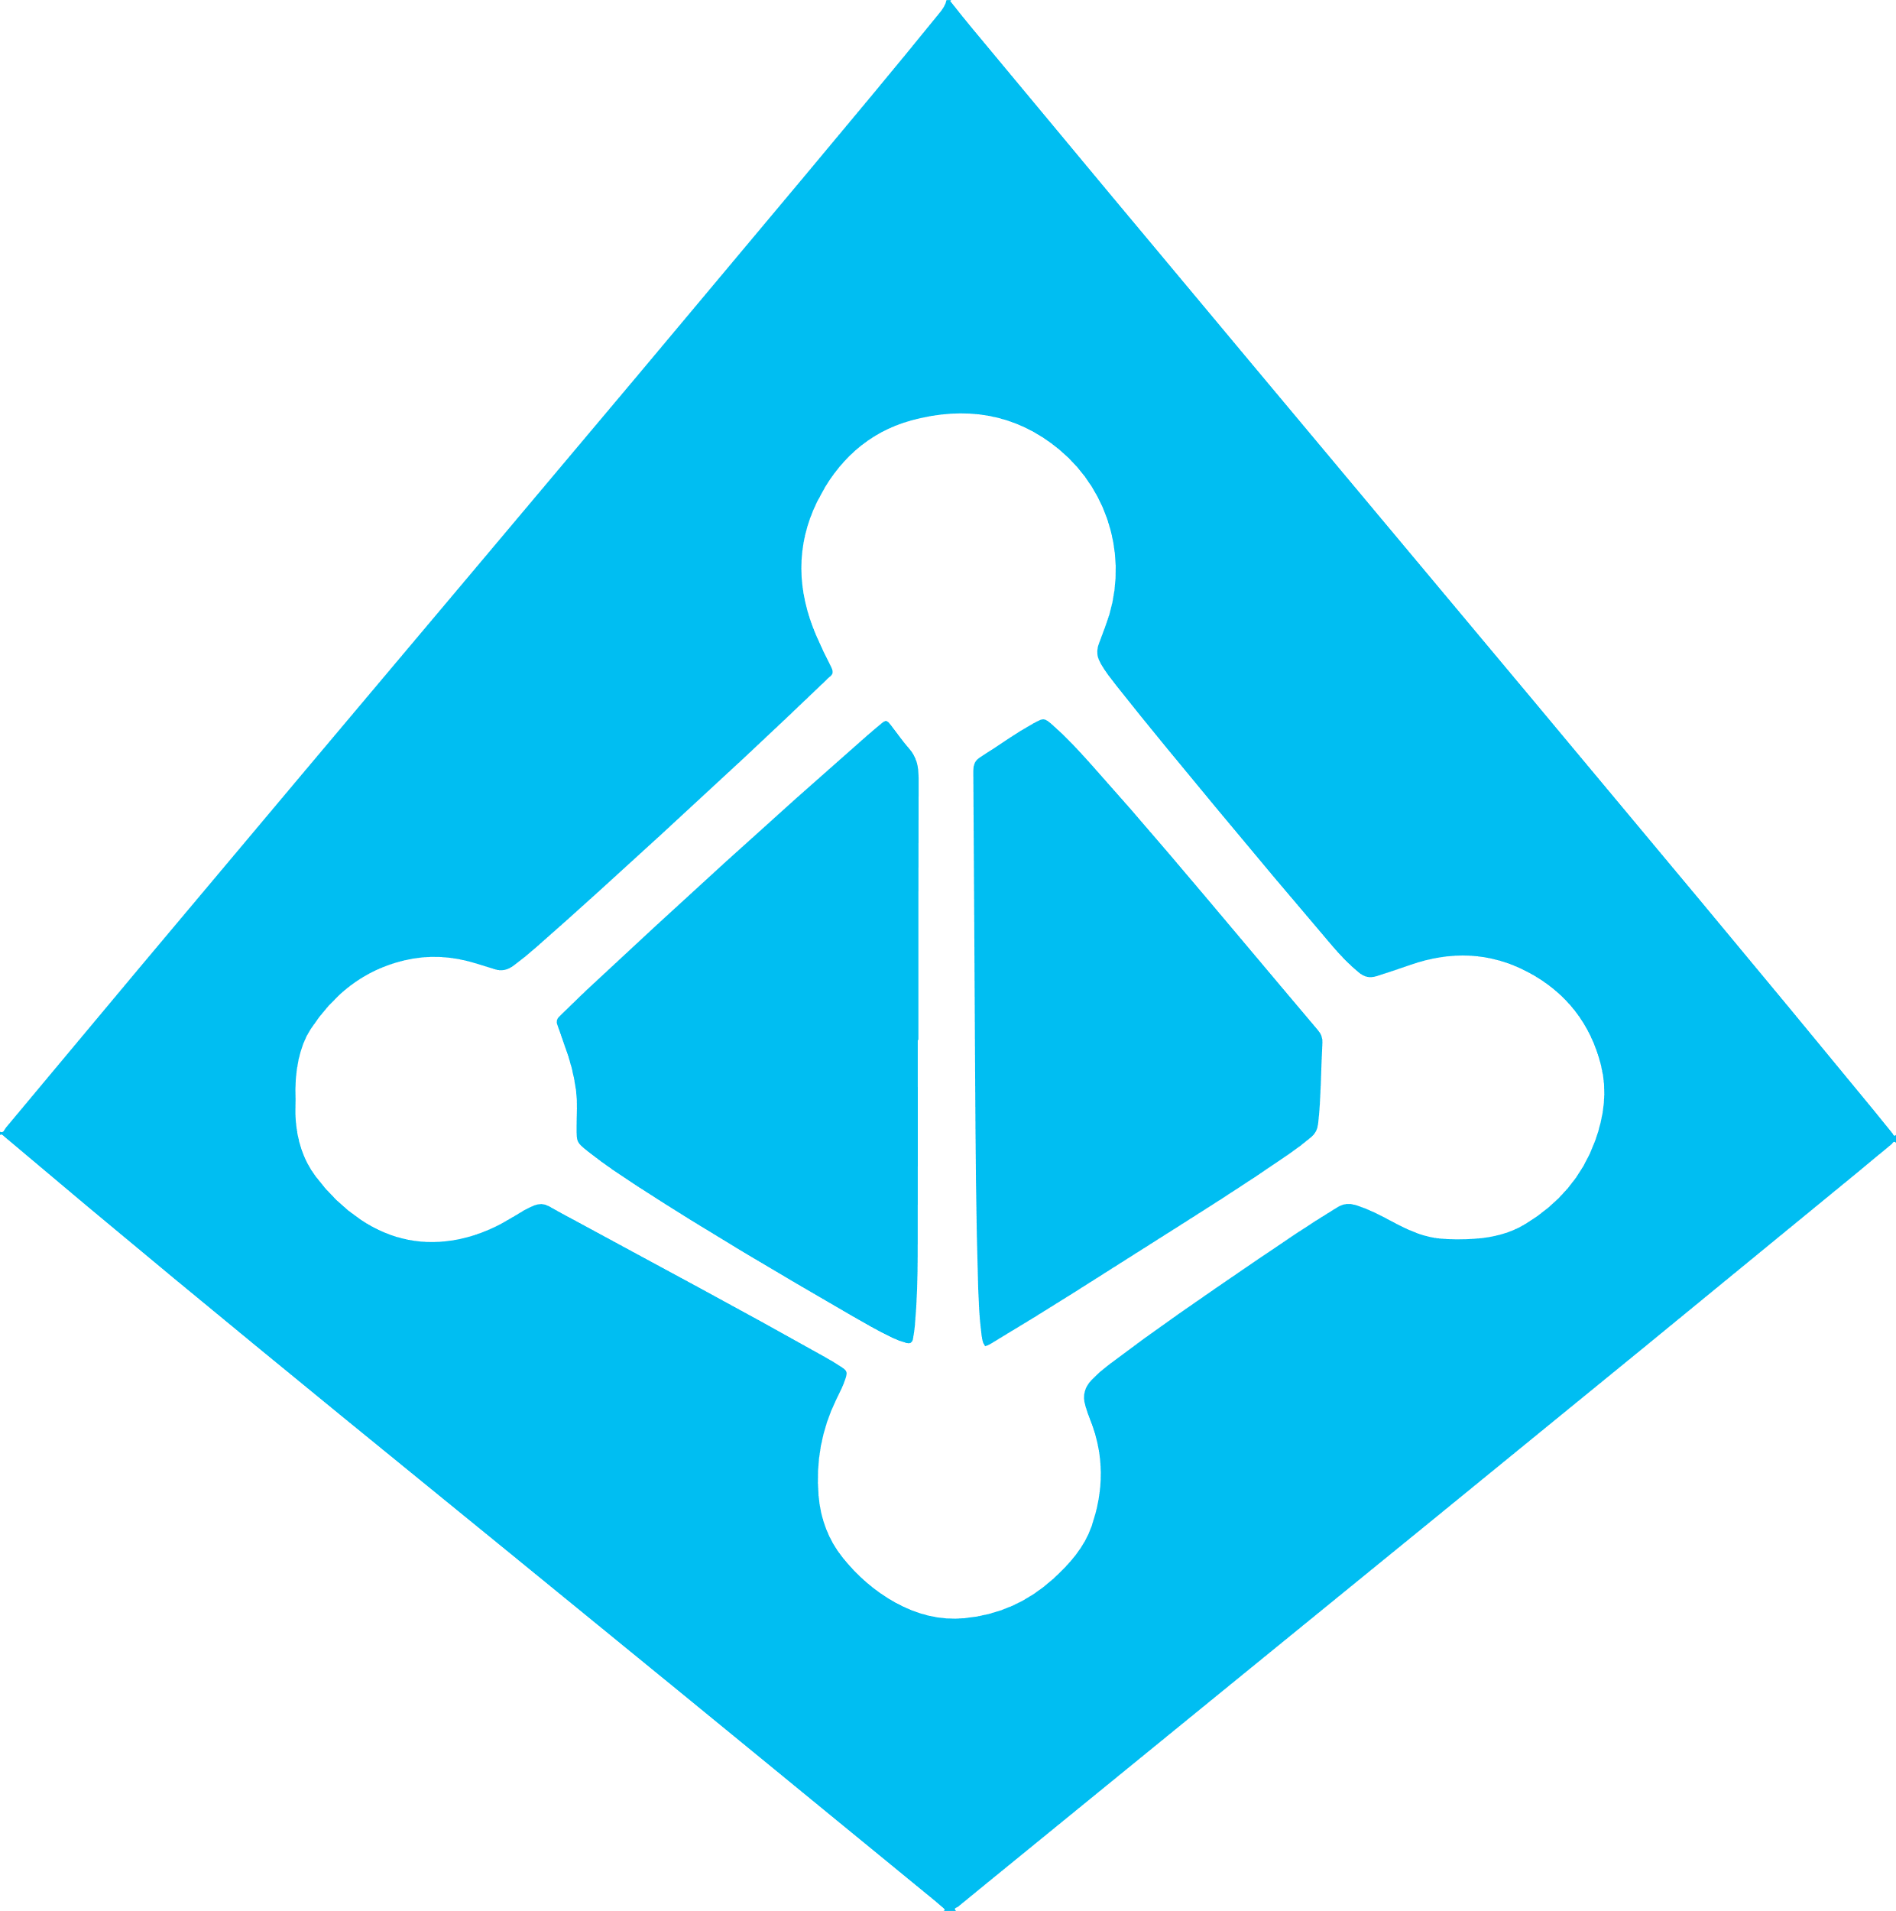


Work how you want with opensource tools and APIs
 | Development | DevOps | Monitoring | Networking | Storage | Security
Take advantage of services and tools in the Kubernetes ecosystem
OR, Leverage growing Azure support
RBAC
Azure Container Registry
AAD
Key Vault
VSTS
ARM
VS Code
Azure Monitor
Azure VNET
Azure Storage

Slide 16

Azure services
Work how you want with opensource tools and APIs
SQL Database
Event Hubs
Azure Kubernetes Service (AKS)
Open Source Broker for Azure (OSBA)
Easily connect to SLA-backed Azure services with OSBA
Redis Cache
Azure Database
for MySQL
ACS Engine
CosmosDB
Azure Database
for PosgreSQL
Service Bus
Azure Storage

Slide 17
Secure your Kubernetes environment
Control access through AAD and RBAC
Safeguard keys and secrets with Key Vault
Secure network communications with VNET and CNI
Compliant Kubernetes service with certifications covering SOC, HIPAA, and PCI

Slide 18
Scale and run applications with confidence
Built-in auto scaling
Global data center to boost performance and reach
Elastically burst from AKS cluster using ACI
Geo-replicated container registry

Slide 19
Top scenarios for Kubernetes on Azure
Lift and shift to containers
Microservices
Machine learning
IoT
Cost saving
without refactoring your app
Agility
Faster application development
Performance
Low latency processing
Portability
Build once, run anywhere

Slide 20
Lift and shift to containers
Microservices
Machine learning
IoT
App Modernization without code changes
Deployment
Existing
application
Modernization
Validate
Move applications as is to Azure, but with cost savings
Containers support all frameworks and technology stacks
Faster app deployment with DevOps tools
Convert
Publish
VM
Container
Azure Container Registry
Azure Kubernetes Service
CI/CD practice
MySQL Server
Migrate
Azure Database for MySQL

Slide 21
kubectl
Internet
Kubernetes Architecture
Worker node
Master node
kubelet
Kube-proxy
Pod
Pod
docker
API server
container
container
container
container
container
container
scheduler
Worker node
Controller-manager (replication, namespace, serviceaccount, …)
kubelet
Kube-proxy
Pod
Pod
docker
etcd
container
container
container
container
container
container

Slide 22
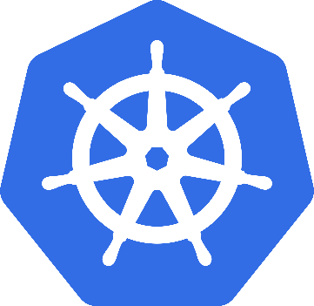
What is Kubernetes?
Background
"Kubernetes is an open-source system for automating deployment, scaling, and management of containerized applications”
Schedules and runs application containers across a cluster of machines
Kubernetes v1.0 released on July 21, 2015. Joe Beda, Brendan Burns, & Craig McLuckie
Key features
Declarative infrastructure
Self-healing
Horizontal scaling
Automated rollouts and rollbacks
Service discovery and load balancing
Automatic bin packing
Storage orchestration
Secret and configuration management
Not a PaaS platform

Slide 23
Kubernetes Architecture Components
api-server
etcd
control plane components
Controller-manager
scheduler
kubelet
Kube-proxy
node components
docker
dns

Slide 24
pod
deployment
Kubernetes Resources
service
Replica set
ingress
Daemon set
job
namespace
Secret
Config-map

Slide 25
Security with Kubernetes
RBAC / Namespaces / Azure AD
Networking Topology
Ingress Controllers
CNI (Container Network Interface) Plug-ins
kubenet
Azure - NSG
VM Patching
Secrets
TLS Key Rotation
Service to Service TLS (Istio)

Slide 26

ACS Engine
ACS Engine
ACS-engine takes the best practices developed for AKS and provides it as an OSS project for deploying unmanaged clusters.
Build fully customized Kubernetes clusters
Easily deploy Kubernetes on Azure Stack
Azure Container Instances (ACI)
Azure Container Registry (ACR)
Open Service Broker API (OSBA)
ACS-engine cluster definition file
Generate template using ACS-engine
ARM template file
Deployed Cluster on Azure
Deploy ARM template using Azure CLI
Release Automation Tools

Slide 27
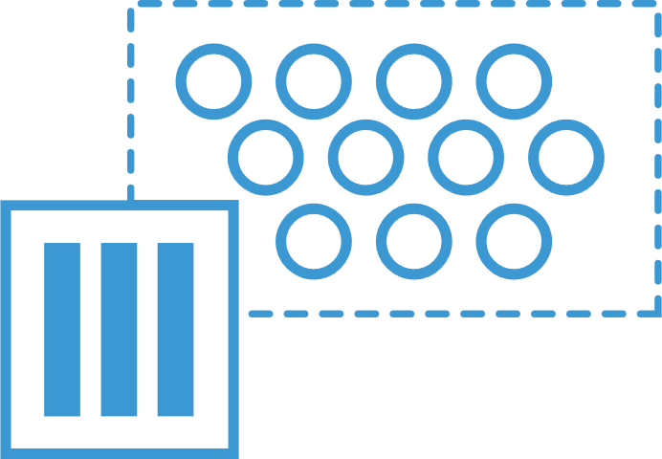
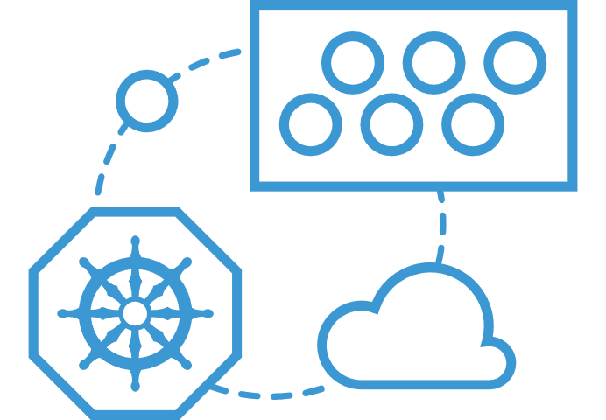
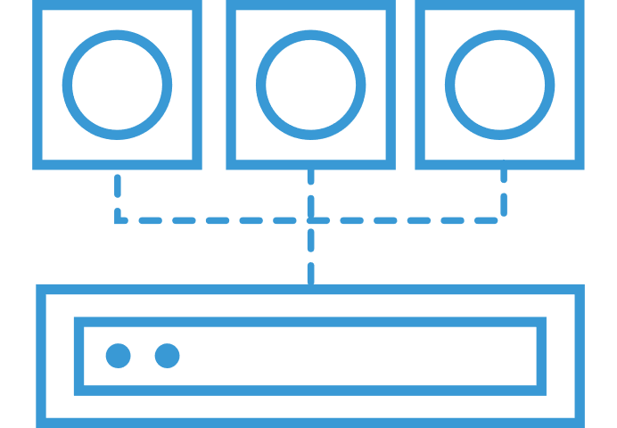
Azure Container Instances (ACI)
ACS Engine
Easily run containers on Azure without managing servers
Azure Container Instances (ACI)
Azure Container Registry (ACR)
Open Service Broker API (OSBA)
Run containers without managing servers
Increase agility with containers on demand
Secure applications with hypervisor isolation
Release Automation Tools

Slide 28
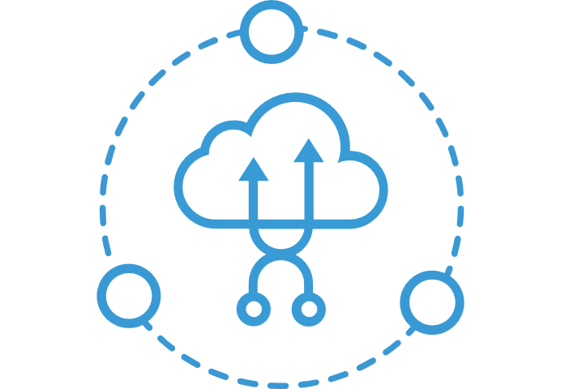
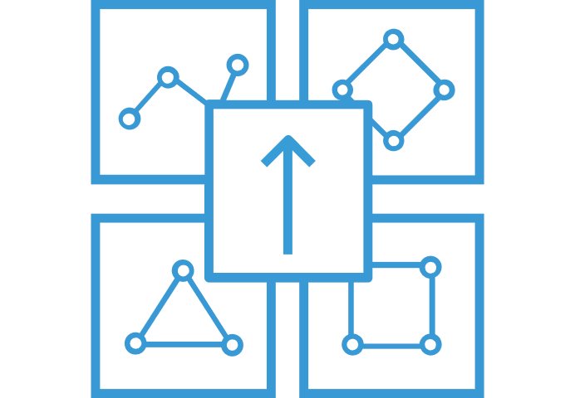
What can you build with ACI
ACS Engine
Azure Container Instances (ACI)
Azure Container Service (AKS) can use the Virtual Kubelet to provision pods inside ACI that start in seconds. Then ACI provides fast, isolated compute to meet traffic that comes in spikes, without the need to manage servers.
Combine ACI with the ACI Logic Apps connector, Azure queues, and Azure Functions to build robust infrastructure that can elastically scale out containers on demand.
Use Azure Container Instances for data processing where source data is ingested, processed, and placed in a durable store such as Azure Blob storage. Achieve significant cost savings through per-second billing.
Elastic bursting with AKS
Azure Container Registry (ACR)
Open Service Broker API (OSBA)
Event-driven applications with Azure Logic Apps
Release Automation Tools
Data processing jobs

Slide 29
Azure Container Instances (ACI)
ACS Engine
Get started easily
Azure Container Instances (ACI)
$ az container create --name mycontainer --image microsoft/aci-helloworld --resource-group myResourceGroup --ip-address public
"ipAddress": {
"ip": "52.168.86.133",
"ports": [...]
},
"location": "eastus",
"name": "mycontainer",
"osType": "Linux",
"provisioningState": "Succeeded",
$ curl 52.168.86.133
<html>
<head>
<title>Welcome to Azure Container Instances!</title>
</head>
Azure Container Registry (ACR)
Open Service Broker API (OSBA)
Release Automation Tools

Slide 30
Azure Container Instances (ACI)
ACS Engine
Bursting with the ACI Connector
PREVIEW
Azure Container Instances (ACI)
VM
VM
Pod
Waste
Pod
Pod
Pod
Waste
Pod
Pod
Pod
Pod
Azure Container Registry (ACR)
Azure Container Instances (ACI)
Pod
Pod
Pod
Pod
Pod
Application architect
Kubernetes control plane
ACI Connector
Pod
Pod
Pod
Pod
Pod
Pod
Pod
Pod
Pod
Pod
Open Service Broker API (OSBA)
Pod
Pod
Pod
Pod
Pod
Deployment/ tasks
Pod
Pod
Pod
Pod
Pod
Infrastructure architect
Release Automation Tools
Pod
Waste
Pod
Pod
Pod
Waste
Pod
Pod
Pod
Pod
VM
VM

Slide 31
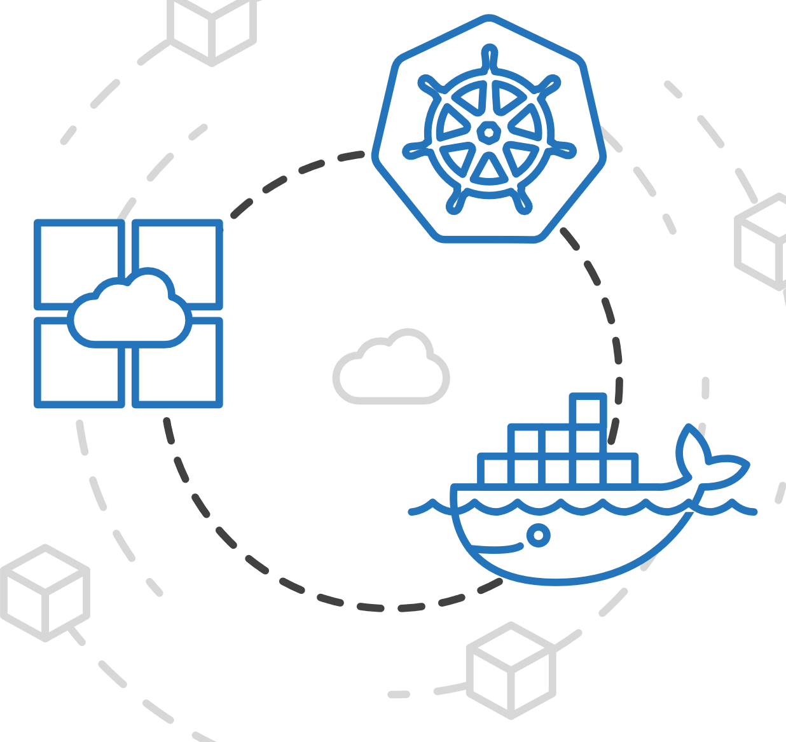
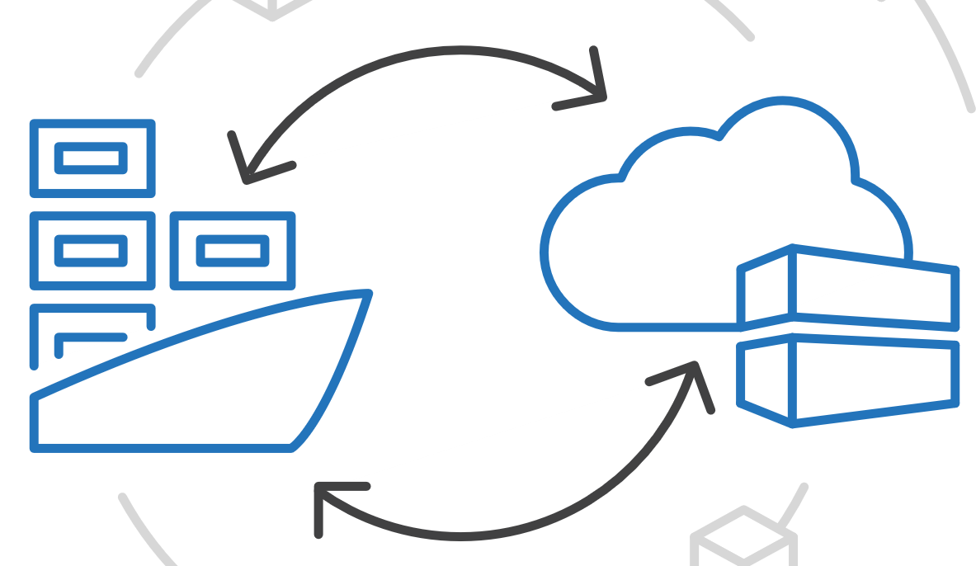
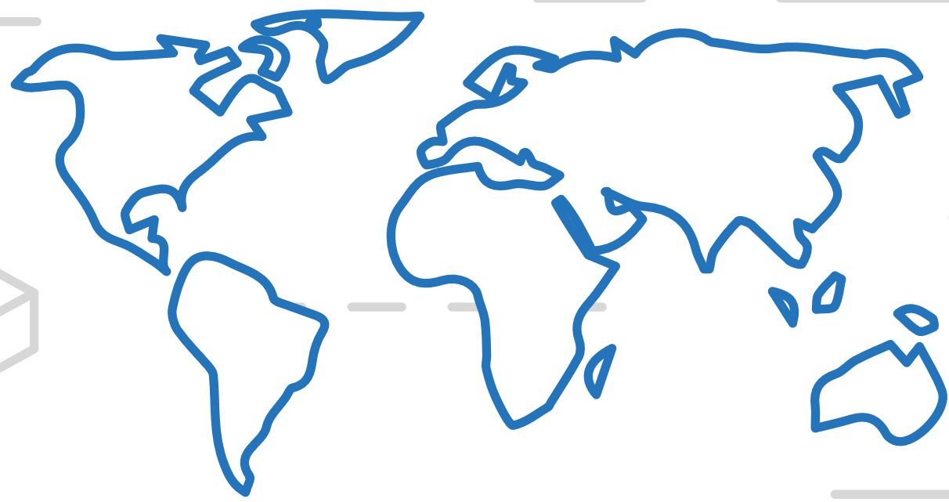
Azure Container Registry (ACR)
ACS Engine
Manage a Docker private registry as a first-class Azure resource
Azure Container Instances (ACI)
Azure Container Registry (ACR)
Open Service Broker API (OSBA)
Manage images for all types of containers
Use familiar, open-source Docker CLI tools
Azure Container Registry geo-replication
Release Automation Tools

Slide 32
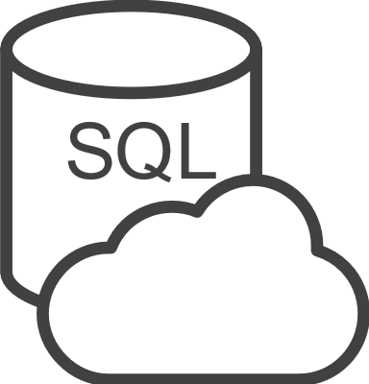





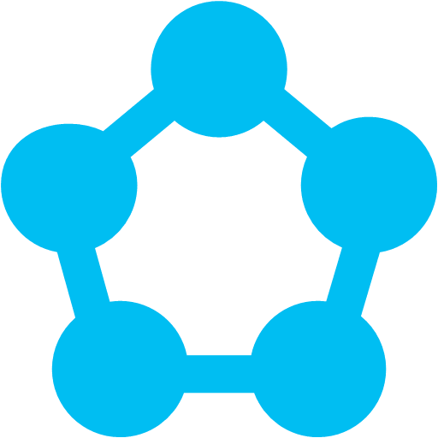
Open Service Broker for Azure (OSBA)
ACS Engine
An implementation of the Open Service Broker API
Azure Container Instances (ACI)
Azure SQL Database
Redis Cache
CosmosDB
And more!
Azure Container Registry (ACR)
Open Service Broker for Azure (OSBA)
Open Service Broker for Azure (OSBA)
Release Automation Tools
OpenShift
Cloud Foundry
Service Fabric (Coming soon)
Kubernetes (AKS)

Slide 33
DevOps Practices Arrive
ACS Engine
Azure Container Instances (ACI)
1.
Business Need/ Use Cases
Product Owner
7.
Monitoring / Operations
Azure Monitor
Azure Container Registry (ACR)
DevOps+ Continuous Delivery Cycle
2.
Software Development Team
6.
Automated Deployment
Open Service Broker for Azure (OSBA)
3.
Software Check-in
5.
Automated Test Scripts
Release Automation Tools
4.
Automated Software Build

Slide 34

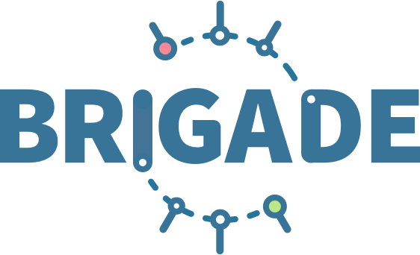

Release automation tools
ACS Engine
Simplifying the Kubernetes experience
Azure Container Instances (ACI)
Azure Container Registry (ACR)
Streamlined Kubernetes development
The package manager for Kubernetes
Event-driven scripting for Kubernetes
Open Service Broker for Azure (OSBA)
Release Automation Tools

